Slide 1

Software Engineering CS-UH 2012, FALL 2024
Final Course Review
Dr. Mohamad Kassab, m.kassab@nyu.edu

Slide 2




Guidance to the final exam

Slide 3


Areas we will review
Software Development Life Cycles
Requirements Engineering
Software Design and Architecture
Software Construction
Software Testing

Slide 4

Software Development Life Cycles

Slide 5

Software development processes
Waterfall
Agile
Scrum
What are the roles of SCRUM team?
The customer keeps making changes to the requirements, even during the design and development phases. What approach could you have employed (could employ) to try to mitigate this problem?
Notes:
You are chief engineer for a safety critical system that is being custom-built for a long-time customer. The customer keeps making changes to the requirements, even during the design and development phases. What approach could you have employed (could employ) to try to mitigate this problem?
Employ a new non- agile development methodology.
Reduce communications with the customer to minimize disagreements.
Have a customer representative at the vendor site at all times.
Increase charges to the customer for every requirements change.

Slide 6

Requirements engineering

Slide 7
Requirements engineering
Elicitation Techniques
Requirements Documentation
Functional Requirements vs. Non-Functional Requirements.
Hazards
Requirements Qualities

Slide 8
IEEE Std 29148
Describes standard for, system engineering including quality requirements
For a single requirement
Singular
Feasible
Unambiguous
Complete
Consistent
Verifiable
Traceable

Slide 9
IEEE Std 29148
For a set of requirements
Complete
Consistent
Bounded
Affordable

Slide 10
Singular
Each requirement specifies a single and have no conjunctions.
3.1.1 The pump control unit shall start the submersible pump motors to prevent the wet well from running over and stop the pump motors before the wet well runs dry.
versus:
3.1.1.1 The pump control unit shall start the submersible pump motors to prevent the wet well from running over.
3.1.1.2 The pump control unit shall stop the pump motors before the wet well runs dry.
Conjunctions can be used if they describe a single behavior
3.2.6 The light emitted by the display shall be either red or yellow.

Slide 11
Feasible
A requirement that can be satisfied with current technology and cost constraints,
Not a ridiculous requirement.
Examples
The system shall consume no power.
The length of the beam shall be less than 0 feet.

Slide 12
Unambiguous
A requirement is unambiguous if it can have only one interpretation.
Example
If the valve is open and the drain is open, then it should be closed.
Conjunctions can cause ambiguity and that is why they should be avoided.

Slide 13
Complete
A requirement is complete “to the extent that all of its parts are present and each part is fully developed.”
Switch 1 shall have two positions, one position is “on”.
Same property for a set of requirements
E.g. no “TBD”

Slide 14
Consistent
A requirement is consistent if it does not contradict itself (internal) or a prevailing standard or law (external).
If the lever is in position 1 then it shall open and close the valve.
Same for a set of requirements (e.g.)
3.1 If the lever is in position 1, then valve 1 is opened.
3.2 If the lever is in position 1, then valve 1 is closed.

Slide 15
Verifiable
Satisfaction of the requirement can be demonstrated
The system shall be user friendly
Usually needs metrics associated with the requirement
Important to always envision the acceptance test along with the requirement
Goal-question-metric paradigm useful

Slide 16
Traceable
Numbered or indexed somehow
Essential quality for effective communications ease of modification, and legal considerations.
Stored in a requirements management tool

Slide 17
Bounded
A set of requirements is bounded if it does not exceed the scope of the system intent.
Important to avoid scope creep.
Refer to mission statement (or conops) to avoid scope creep;
e.g. does this requirement fit the mission?

Slide 18
Affordable
For a set of requirements meets budgetary constraints.
Affordability analysis discussed later

Slide 19
Ranked
Not a 29148 mandated quality, but…
Important for design decisions, tradeoff analysis, budget negotiations and more
Rank can be ordinal (1, 2, 3, …) or subjective (high, medium, low), or based on need (mandatory, desirable, optional)
Two requirements can hold the same rank
Ranking is part of the requirements agreement process

Slide 20

Writing Requirements as Use Cases

Slide 21
Useful Use Case Guidelines
Complete Single Goal
Leveled Steps
Technology Neutral
Scenario Plus Fragments
Exhaustive Alternatives
Common Sub Behavior
Interrupts As Extensions
Notes:
Explained on upcoming slides

Slide 22

Requirements and Risk Management

Slide 23
Win-win negotiating
Understand people’s expectations
Set the ground rules up front
Look for early successes
Be sure to give a little
Conclude negotiating only when all parties are satisfied

Slide 24
Negotiating techniques
Always give a little
Never give anything away for free
Customers are often willing to shed requirements once they understand
the cost of implementing
the cost of testing the feature

Slide 25
Example 2
Trade schedule for cost
Upon pressing the “launch missile button”, the system shall launch the missile within 40 ms.
Cost: $75K, 2 staff months
Alternative: Maintain cost but relax schedule to 4 months.

Slide 26
Example 3
Trade cost for risk
Upon pressing the “launch missile” button, the system shall launch the missile within 40 ms with 99% certainty.
Alternative: Recognize that hard schedulability guarantees are virtually impossible and expensive.

Slide 27
Example 4
Trade performance (accuracy) for cost
Upon pressing the “launch missile” button, the system shall launch the missile within 100 ms.
Alternative: Relax time to launch in order to meet schedulability constraints.

Slide 28
Win - Win
A vendor offers you a custom built product at a price of $2 million with delivery to take place in 1 year. Your budget will only allow you to spend $1.5 million. Which of the following is NOT a good win-win negotiating strategy?
offer to pay $1.5 million but with delivery to be taken in 1.5 years.
offer to pay $1.5 million for the same feature set.
offer to pay $1.5 million for a reduced feature set.
offer to pay $1.5 million for a reduced feature set delivered in 1.5 years.

Slide 29

Software Design

Slide 30

Object Oriented Design
Use Cases → System Sequence Diagrams → Domain Model → Operation Contract → Interaction Diagram → Class Diagram

Slide 31
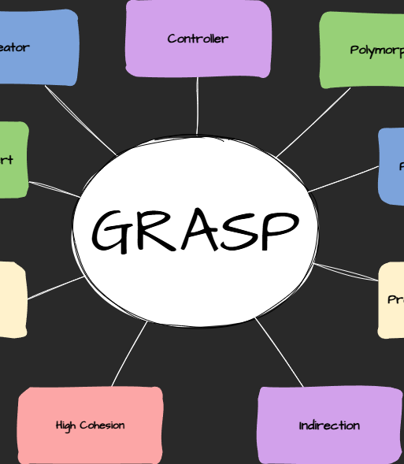
GRASP Patterns
Expert
Controller
Creator
Indirection
High Cohesion/Low Coupling
Polymorphism
Indirection
Pure Fabrication
Don’t talk to strangers

Slide 32
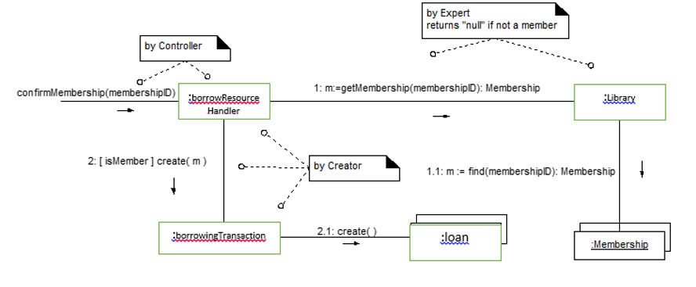

Slide 33
Software Architecture Design
Software Architectural Patterns:
Layered
Broker
MVC
Client Server
Pipes – Filter
Publish Subscribe
Notes:
The Pipes and Filters architectural pattern is particularly beneficial for:
Real-time processing of large datasets.
Sequential execution of tasks.
Hierarchical organization of components.
Centralized control of system interaction.

Slide 34
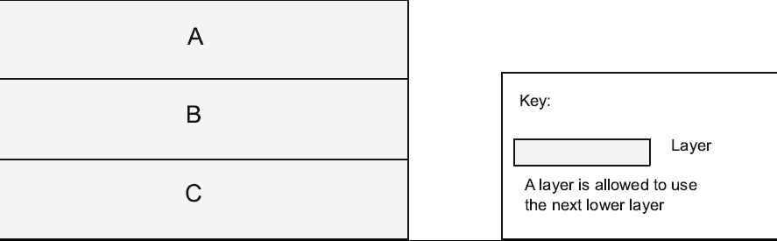
Layer Pattern Example

Slide 35
Broker Example

Slide 36
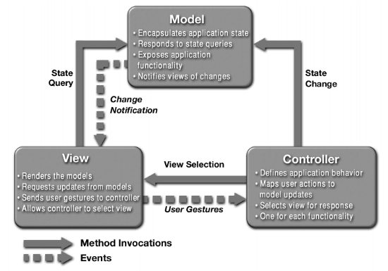
MVC Example

Slide 37
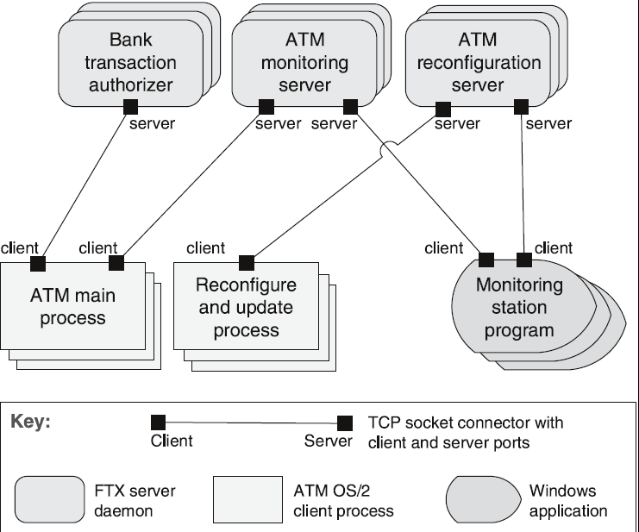
Client-Server Example

Slide 38
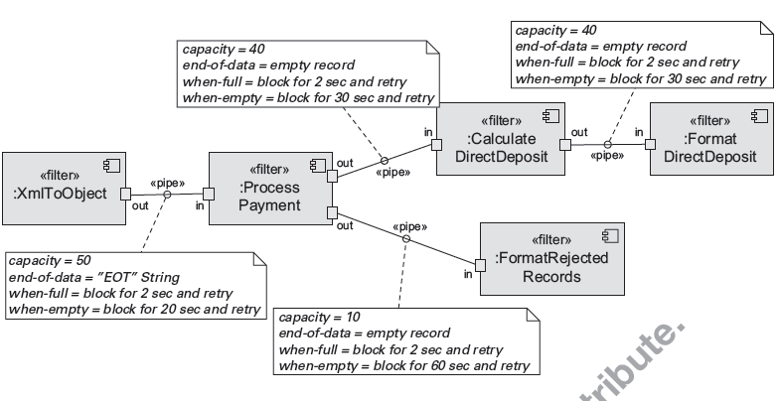
Pipe and Filter Example

Slide 39
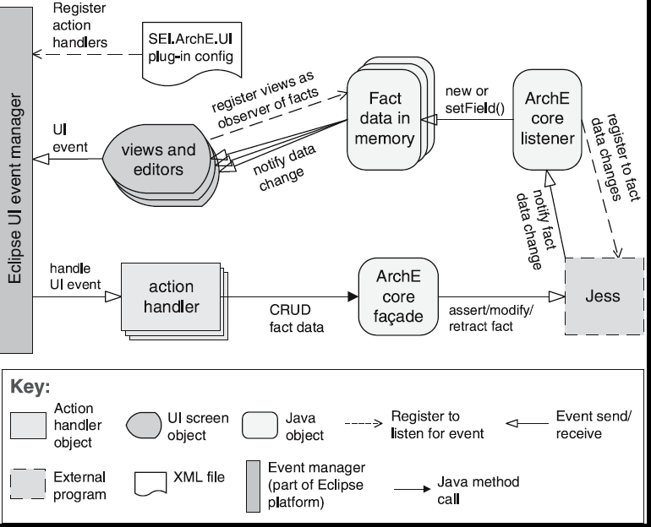
Publish-Subscribe Example

Slide 40

Software Construction

Slide 41

Software Construction
Version Control
Refactoring:
The primary goal is to o improve the internal structure of the code without changing its external behavior.

Slide 42
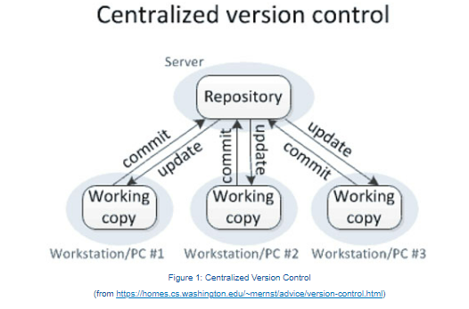
A centralized VCS has a star topology with the shared repository at the center.
The main feature of a centralized VCS is its simplicity.
There is only one repository and that is where the "golden" copy of the source is to be found.
The usage commands are also simple: 1) commit my changes to the repository 2) update my working copy with changes from other team members.

Slide 43
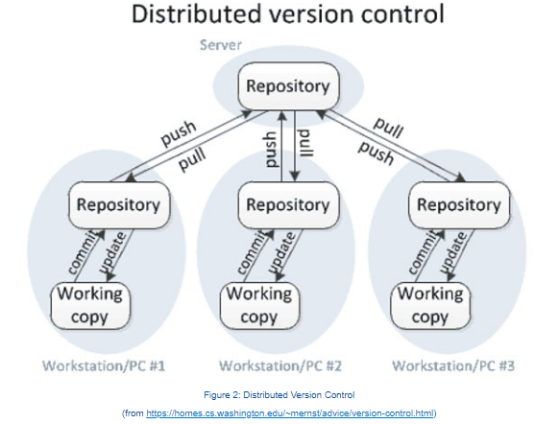
A distributed VCS can have many topologies due to its distributed design. Any repository may be considered "the" repository since each is a peer to the others.
The main feature of a distributed VCS is the support of workflows between different project members.
This comes at the cost of having a two level commit and update process.

Slide 44

Software Testing

Slide 45
Software Testing
Black Box Testing
White Box Testing
Control Flow Testing
Data Flow Testing
System Testing
System Testing Planning
System Testing Execution
The primary objective of test case design for software is to create a set of tests that:
Are most likely to find defects.
The cost of fixing a fault:
Increases as we move the product towards live use.

Slide 46
White Box Testing Techniques
Control Flow Testing
Data Flow Testing

Slide 47
Control Flow Testing

Slide 48
Control Flow Testing: Basic Idea
Two kinds of basic program statements:
Assignment statements (Ex. x = 2*y; )
Conditional statements (Ex. if(), for(), while(), …)
Control flow
Successive execution of program statements is viewed as flow of control.
Conditional statements alter the default flow.

Slide 49
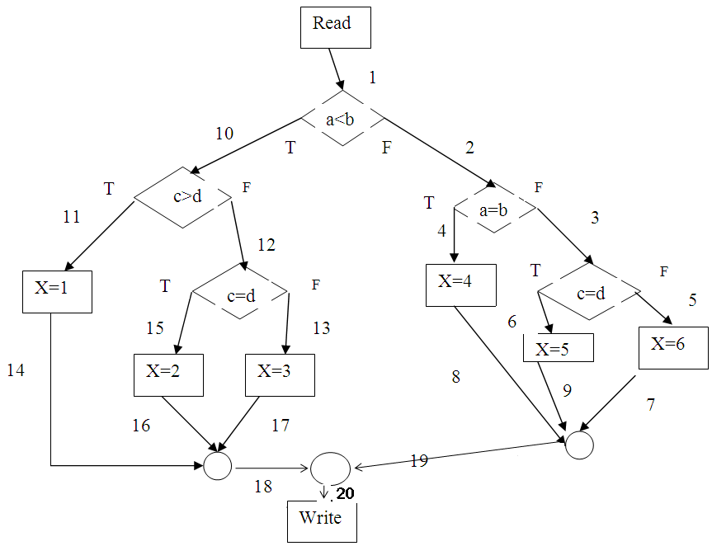
Control Flow Testing: Basic Idea
Start node
Decision node
Procedure node
read(a,b,c,d);
if a < b then if c > d then x := 1 else if c = d then x := 2
else x := 3 else if a = b then x := 4 else if c = d then x := 5
else x := 6;
write(x);
Terminal node

Slide 50
Program Path
A program path is a sequence of statements from entry to exit.
There can be a large number of paths in a program.
There is an (input, expected output) pair for each path.
Executing a path requires invoking the program unit with the right test input.
Paths are chosen by using the concepts of path selection criteria.
Tools: Automatically generate test inputs from program paths.

Slide 51
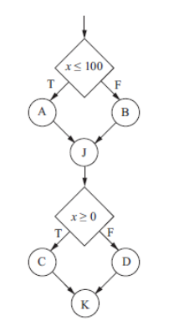
Feasible vs. Infeasible Paths
Two kinds of paths
Executable path: There exists input so that the path is executed.
Infeasible path: There is no input to execute the path.
Consider the control flow graph shown where: A, B, J, C, D and K are computation nodes that do not affect the value of x.

Slide 52
Outline of Control Flow Testing
The process of generating test input data for control flow testing.

Slide 53
Outline of Control Flow Testing*
Inputs to the test generation process
Source code
Path selection criteria: statement, branch, …
Generation of control flow graph (CFG)
A CFG is a graphical representation of a program unit.
Compilers are modified to produce CFGs. (You can draw one by hand.)
Selection of paths
Enough entry/exit paths are selected to satisfy path selection criteria.
Generation of test input data
Two kinds of paths
Executable path: There exists input so that the path is executed.
Infeasible path: There is no input to execute the path.
Solve the path conditions to produce test input for each path.
*Also known as decision-to-decision path testing (dd-path testing).

Slide 54
Control-Flow Graph (Flowgraph)
Procedure node
(out-degree=1)
Start node
(in-degree=0)
Quadruple (E, N, s, t)
N : set of nodes
s: Start node
t: Terminal node
E : set of edges
In-degree (FAN-IN): number of edges arriving at node
Out-degree (FAN-OUT): number of edges leaving the node
Path: sequence of consecutive edges
s
Decision node
(out-degree>1)
Terminal node
(out-degree=0)
t

Slide 55
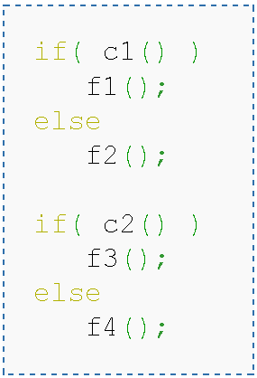
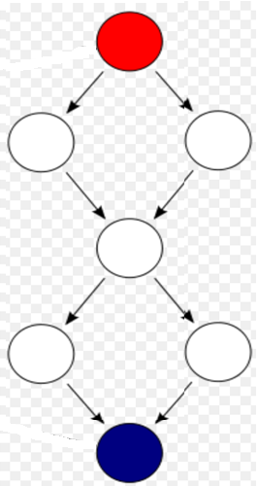
CFG Example
Notes:
Incidence matrix

Slide 56
CFG : The if Statement
if (x < y)
{
y = 0;
x = x + 1;
}
else
{
x = y;
}
1
x < y
x >= y
y = 0
x = x + 1
2
3
x = y
4
1
if (x < y)
{
y = 0;
x = x + 1;
}
x < y
y = 0
x = x + 1
2
x >= y
3

Slide 57
CFG : while and for Loops
x = 0;
while (x < y)
{
y = f (x, y);
x = x + 1;
}
x = 0
1
dummy node
2
x < y
x >= y
implicitly initializes loop
x = 0
1
3
4
y =f(x,y)
x = x + 1
2
x < y
x >= y
for (x = 0; x < y; x++)
{
y = f (x, y);
}
y = f (x, y)
3
5
4
x = x + 1
implicitly increments loop

Slide 58
CFG : The case (switch) Structure
read ( c) ;
switch ( c )
{
case ‘N’:
y = 25;
break;
case ‘Y’:
y = 50;
break;
default:
y = 0;
break;
}
print (y);
1
read ( c );
c == ‘N’
c == ‘Y’
default
2
3
4
y = 25;
break;
y = 0;
break;
y = 50;
break;
5
print (y);

Slide 59
Example: CFG for ComputeStats
public static void computeStats (int [ ] numbers)
{
int length = numbers.length;
double med, var, sd, mean, sum, varsum;
sum = 0;
for (int i = 0; i < length; i++)
{
sum += numbers [ i ];
}
med = numbers [ length / 2 ];
mean = sum / (double) length;
varsum = 0;
for (int i = 0; i < length; i++)
{
varsum = varsum + ((numbers [ I ] - mean) * (numbers [ I ] - mean));
}
var = varsum / ( length - 1.0 );
sd = Math.sqrt ( var );
System.out.println ("length: " + length);
System.out.println ("mean: " + mean);
System.out.println ("median: " + med);
System.out.println ("variance: " + var);
System.out.println ("standard deviation: " + sd);
}
1
start
2
i = 0
3
i <
length
i >=
length
4
5
i++
i = 0
6
i <
length
i >=
length
7
8
i++
Introduction to Software Testing (Ch 2), www.introsoftwaretesting.com
© Ammann & Offutt
59
Notes:
59

Slide 60
Exercise
Here is a short program segment:
read(a,b,c,d);
if a < b then if c > d then x := 1 else if c = d then x := 2
else x := 3 else if a = b then x := 4 else if c = d then x := 5
else x := 6;
write(x);
For the code fragment above, draw the corresponding flowgraph

Slide 61
Solution

Slide 62
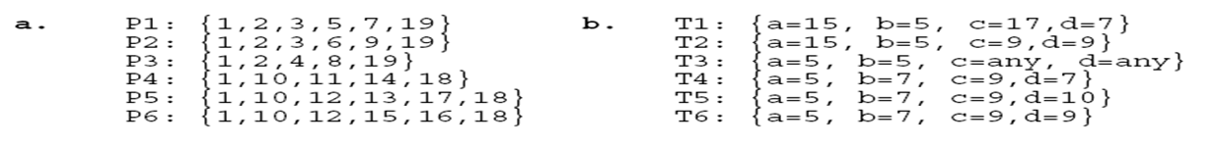
Paths in a Control Flow Graph
A few paths:

Slide 63
Outline of Control Flow Testing
The process of generating test input data for control flow testing.

Slide 64
Path Selection Criteria
Program paths are selectively executed.
Question: What paths do I select for testing?
The concept of path selection criteria is used to answer the question.
Advantages of selecting paths based on defined criteria:
Ensure that all program constructs are executed at least once.
Repeated selection of the same path is avoided.
One can easily identify what features have been tested and what not.
Path selection criteria
Select paths to achieve complete statement coverage.
Select paths to achieve complete branch coverage.
Simple Path coverage.
All Path coverage.
Visit each loop
Select paths to achieve predicate coverage (Make sure that each possible outcome from a condition is tested at least once).
Linearly Independent Paths

Slide 65
Statement coverage criterion
Statement coverage means executing individual program statements and observing the output.
100% statement coverage means all the statements have been executed at least once.
Cover all assignment statements.
Cover all conditional statements.
Less than 100% statement coverage is unacceptable.

Slide 66
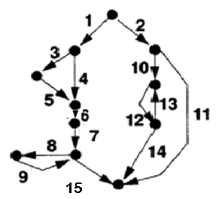
Statement Coverage: Example
Minimum number of test cases: 2
Paths: <2 10 12 14>, <1 3 5 6 7 8 9 15>

Slide 67
Branch coverage criterion
A branch is an outgoing edge from a node in a CFG.
A condition node has two outgoing branches corresponding to the True and False values of the condition.
Covering a branch means executing a path that contains the branch.
Find a set of paths such that every edge lies on at least one path
100% branch coverage means selecting a set of paths such that each branch is included on some path.

Slide 68
Branch Coverage: Example
Minimum number of test cases: 4
Paths: <2 11>, <2 10 12 13 12 14>, <1 3 5 6 7 15>, <1 4 6 7 8 9 15>

Slide 69
Simple Path Coverage
Strategy:
every simple path (which does not contain the same edge more than once) is executed once

Slide 70
Simple Path Coverage: Example
Minimum number of test cases: 6
Paths: <2 11>, <2 10 12 14>, <1 3 5 6 7 15>, < 1 4 6 7 15>, <1 3 5 6 7 8 9 15>, <1 4 6 7 8 9 15>

Slide 71
All Path Coverage
Strategy:
every possible program path is executed at least once
In terms of flowgraph: find all DD-paths through the flowgraph

Slide 72
All Path Coverage: Example
Minimum number of test cases: Infinite
Paths: <2 11>, <2 10 12 14>, <2 10 12 (13 12)^{n} 14>, <1 3 5 6 7 15>, < 1 4 6 7 15>, <1 3 5 6 7 (8 9)^{n} 15>, <1 4 6 7 (8 9)^{n} 15> (any n>0)

Slide 73
Visit-Each-Loop Coverage
Strategy:
skip the loop entirely
only one pass through the loop
Notes:
If loops are nested this results in the same multiplicity of test cases we’ll find with boundary value analysis

Slide 74
Visit-Each-Loop Coverage: Example
Minimum number of test cases: 7
Paths: <2 11>, <2 10 12 14>, <2 10 12 13 12 14>, <1 3 5 6 7 15>, < 1 4 6 7 15>, <1 3 5 6 7 8 9 15>, <1 4 6 7 8 9 15>

Slide 75
Predicate coverage criterion
If all possible combinations of truth values of the conditions affecting a path have been explored under some tests, then we say that predicate coverage has been achieved.

Slide 76
McCabe’s Cyclomatic Complexity

Slide 77
McCabe Example
A program fragment : all variables are int
1. i=1;
2 if (a< b)
3 a=a+b;
4 else
5 b=a+c;
6 while (i<20)
7 {
8 if (b<c)
9 {
10 if (b>c)
11 b=b+a;
12 }
13 else
14 c=b+a;
15 i++;
16 }
I added line numbers for ease of analysis

Slide 78
A
11 edges and 8 nodes
Condense line numbers together as follows:
A=1,2;
B=3;
C=4,5;
D=6,7,8;
E=9,10;
F=11;
G=12,15,16, and
H=13,14 we see that the program graph is →
B
C
D
E
H
Noted: You can draw a graph that assigns a node to each syntactic element of the program (including { and }, which had 16 nodes and 19 edges
This is a perfectly correct approach, and you are less likely to make mistakes this way.
For efficiency, however, I chose to condense line numbers.)
F
G

Slide 79
Example, Continued
From the graph we can see that e=11 and n=8.
Now with c=e-n+2 we have c=11-8+2 = 5.
As a check, you can count the number of simple branches (if and while statements without complex predicates) and add one to it. There are 4 simple branches so c=4 + 1 = 5.

Slide 80
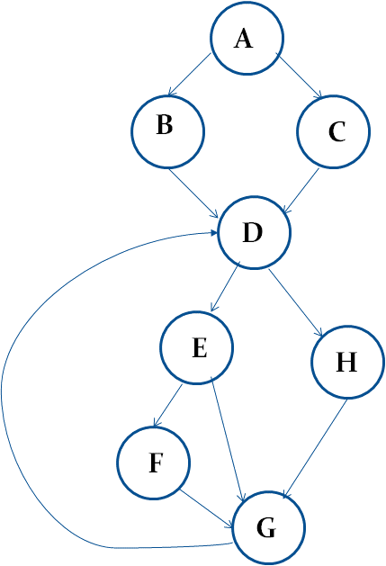
Linearly Independent Paths
The cyclomatic complexity of a section of source code is the maximum number of linearly independent paths within it—where "linearly independent" means that each path has at least one edge that is not in one of the other paths.
One set of 5 independent paths is:
1: ABDEFGD…
2: ABDEG…
3: ABDHG…
4: ACDE…
5: ACDHG…
List the independent code paths in this code.
Note that path 4 covers both ACDEFGD…and ACDEG …because DEFGD and DEG are in paths 1 and 2. Now, converting A-G to their corresponding line numbers gives the test paths in terms of the code.
Note: you can get a different set that is also correct – for a code graph vector space there can be more than one basis set.

Slide 81
Code coverage requirements
Low code coverage indicates inadequate testing, but 100% coverage is impossible in practice and generally not cost effective.
Although 100% code coverage may appear like a best possible effort, even 100% code coverage is estimated to only expose about half the faults in a system.
Code coverage of 70-80% is a reasonable goal for system test of most projects with most coverage metrics.
Empirical studies of real projects found that increasing code coverage above 70-80% is time consuming and therefore leads to a relatively slow bug detection rate

Slide 82
Minimum Acceptable Code Coverage Standards
The aviation standard DO-178B requires 100% code coverage for safety critical system
The standard IEC 61508:2010 "Functional Safety of Electrical/Electronic/Programmable Electronic Safety-Related Systems" recommends 100% code coverage of several metrics, but the strenuousness of the recommendation relates to the criticality.
The IEEE Standard for Software Unit Testing section 3.1.2 specifies 100% statement coverage as a completeness requirement. Section A9 recommends 100% branch coverage for code that is critical or has inadequate requirements specification.

Slide 83
Assessment – Feasible Path
In the control flow graph shown, A, B, C, D and J are computation nodes that do not affect the value of variable x.
If there is no limit to the number of test case, how many different feasible execution paths can be tested?

Slide 84
Assessment – Coverage Criteria
Which of the following statements are true?
100% branch coverage guarantees 100% All paths coverage.
100% statement coverage guarantees 100% branch coverage.
100% statement coverage guarantees 100% All paths coverage.
100% branch coverage guarantees 100% statement coverage.

Slide 85
Assessment – All Path testing
You have been asked by your supervisor to "exhaustively test" the software for a mission critical system using All-Paths testing. What is the most appropriate response to give to the supervisor?
It is impossible to do this kind of testing
All-paths testing can be completed in a reasonable amount of time without even using automation.
All-paths testing can be performed but will take forever.
All-paths testing can be performed on small portions of the most critical code using automation and given enough time.

Slide 86
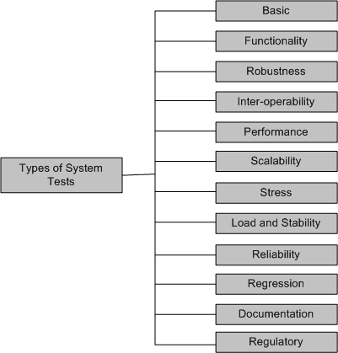
Taxonomy of System Tests
Figure 8.1: Types of system tests

Slide 87

Exploratory Testing

Slide 88
Requirement Links to Tests : Level 3

Slide 89
Requirement linkage to Tests : Level 4

Slide 90
Testing Complexity
Look at the number of requirements, the number linkages and the number of tests.

Slide 91

System Test Planning and Execution
Sections of the Test Plan document; for example:
“Why do we have “Exit criteria” in a testing cycle plan?
Important Metrics to remember:
Defect Removal Efficiency (DRE)
Spoilage Metric

Slide 92
Best of Luck in your Final Exam

